Slide 1
Electrical and Electronic Measurements
Part (2)
Signal Generators & Sensors
Lecture 5
د. باسم ممدوح الحلوانى

Slide 2
Introduction to Sensors & Transducers
Sound Transducers
Sound is the generalized name given to “acoustic waves”.
Sound is basically a waveform of energy that is produced by some form of a mechanical vibration
These acoustic waves have frequencies ranging from just 1Hz up to 20 kHz
Sound requires a medium for transmission either through the air, a liquid, or a solid to be “heard”
Microphone (mic)
Input-type Sound Transducers (Sensor) convert sound into and electrical signal
loudspeaker
Output-type Sound Transducers (actuators) convert the electrical signals back into sound

Slide 3
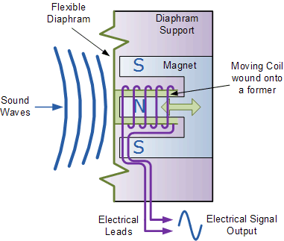
Sound Transducers
The Microphone Input Transducer
it produces an electrical analog output signal which is proportional to the “acoustic” sound wave acting upon its flexible diaphragm.
Many types are available such as Dynamic Moving-coil , condenser , Piezo-electric Crystal microphones
Dynamic Moving-coil Microphone Sound Transducer
It has a very small coil of thin wire suspended within the magnetic field of a permanent magnet.
As the sound wave hits the flexible diaphragm, the diaphragm moves back and forth in response to the sound pressure acting upon it
This causes the attached coil of wire to move within the magnetic field of the magnet.
The movement of the coil within the magnetic field causes a voltage to be induced in the coil as defined by Faraday’s law
The resultant output voltage signal from the coil is proportional to the pressure of the sound wave

Slide 4
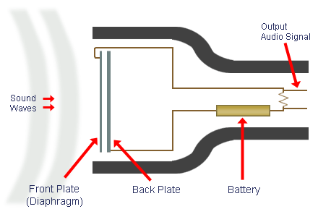
Sound Transducers
The Microphone Input Transducer
Condenser Microphone
Condenser means capacitor, the term condenser is actually obsolete but has stuck as the name for this type of microphone.
This Mic uses a capacitor to convert acoustical energy into electrical energy.
It requires power from a battery or external source.
The resulting audio signal is stronger signal than that from a dynamic.
Condensers also tend to be more sensitive and responsive than dynamics,
One of these plates is made of very light material and acts as the diaphragm.
The diaphragm vibrates when struck by sound waves, changing the distance between the two plates and therefore changing the capacitance

Slide 5
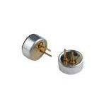
Sound Transducers
The Microphone Input Transducer
Electret Condenser Microphone
The electret condenser mic uses a special type of capacitor which has a permanent voltage built in during manufacture. This is somewhat like a permanent magnet, in that it doesn't require any external power for operation.
An electret microphone is an omnidirectional microphone, which means it can capture sound from all directions.

Slide 6
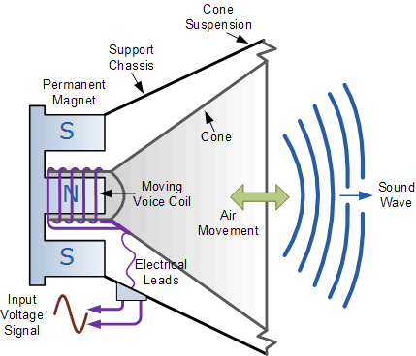
Sound Transducers
The Loudspeaker Output Transducer
Its job is to convert complex electrical analogue signals into sound waves being as close to the original input signal as possible.
Loudspeakers are available in all shapes, sizes and frequency ranges with the more common types being moving coil, electrostatic, isodynamic and piezoelectric.
Moving Coil Loudspeaker :
The principle of operation of the Moving Coil Loudspeaker is the exact opposite to that of the “Dynamic Microphone”
A coil of fine wire, called the “speech or voice coil”, is suspended within a very strong magnetic field, and is attached to a paper or Mylar cone, called a “diaphragm” which itself is suspended at its edges to a metal frame or chassis.
When an signal passes through the voice coil, an electro-magnetic field is produced which opposes the main permanent magnetic field around it and tries to push the coil in one direction or the other.
Since the coil is attached to the cone/diaphragm, the movement causes a disturbance in the air around it thus producing a sound

Slide 7
Proximity Sensors
Proximity sensors detect the presence or absence of objects using electromagnetic fields, light, and sound.
There are many types, each suited to specific applications and environments.
Types of proximity sensors
Non-Contact Sensors :
Optical
Ultrasonic
Inductive
Capacitive
Contact Sensors (Mechanical)

Slide 8
Proximity Sensors
Optical (Photoelectric) proximity Sensors
Photoelectric sensors are so versatile that they solve the bulk of problems
All photoelectric sensors consist of a few of basic components:
  An emitter light source (Light Emitting Diode, Infra-red LED, laser diode),
  A photodiode or phototransistor receiver to detect emitted light, and
  Supporting electronics designed to amplify the receiver signal.
Photoelectric proximity Sensors Configurations:
Through-beam
Retro-reflective
Diffuse

Slide 9
Optical sensors (Through-beam)
Transmitter
Receiver

Slide 10
Optical sensors (Through-beam)
Transmitter
Receiver

Slide 11
Optical sensors (Through-beam)
Target
Transmitter
Receiver

Slide 12
Optical sensors (Through-beam)
Transmitter
Receiver

Slide 13
Optical sensors (Through-beam)
Transmitter
Receiver

Slide 14
Optical sensors (Through-beam)
Transmitter
Receiver

Slide 15
Optical sensors (Through-beam)
Transmitter
Receiver

Slide 16
Optical sensors (Through-beam)
Transmitter
Receiver

Slide 17
Optical sensors (Through-beam)
Transmitter
Receiver

Slide 18
Optical sensors (Through-beam)
Transmitter
Receiver

Slide 19
Optical sensors (Through-beam)
Transmitter
Receiver

Slide 20
Optical sensors (Through-beam)
Target
Transmitter
Receiver
Long sensing distance: up to 30 metres with some devices
Will detect all but very transparent materials
Must be accurately aligned

Slide 21
Optical sensors (Retro-reflective)
Type : Retro reflective
T
R
Transmitter /Receiver
Reflector (prismatic)

Slide 22
Optical sensors (Retro-reflective)
Type : Retro reflective
T
R
Transmitter /Receiver
Reflector (prismatic)

Slide 23
Optical sensors (Retro-reflective)
Type : Retro reflective
T
R
Transmitter /Receiver
Reflector (prismatic)

Slide 24
Optical sensors (Retro-reflective)
Type : Retro reflective
Target
T
R
Transmitter /Receiver
Reflector (prismatic)

Slide 25
Optical sensors (Retro-reflective)
Type : Retro reflective
T
R
Transmitter /Receiver
Reflector (prismatic)

Slide 26
Optical sensors (Retro-reflective)
Type : Retro reflective
T
R
Transmitter /Receiver
Reflector (prismatic)

Slide 27
Optical sensors (Retro-reflective)
Type : Retro reflective
T
R
Transmitter /Receiver
Reflector (prismatic)

Slide 28
Optical sensors (Retro-reflective)
Type : Retro reflective
T
R
Transmitter /Receiver
Reflector (prismatic)

Slide 29
Optical sensors (Retro-reflective)
Type : Retro reflective
T
R
Transmitter /Receiver
Reflector (prismatic)

Slide 30
Optical sensors (Retro-reflective)
Type : Retro reflective
T
R
Transmitter /Receiver
Reflector (prismatic)

Slide 31
Optical sensors (Retro-reflective)
Type : Retro reflective
T
R
Transmitter /Receiver
Reflector (prismatic)
Sensing distance : 1/2 to 1/3 of through-beam type
Not suitable for reflective or transparent targets

Slide 32
Optical sensors (Diffuse)
Type : Diffuse
Target
T
R
Transmitter /Receiver

Slide 33
Optical sensors (Diffuse)
Type : Diffuse
T
R
Transmitter /Receiver

Slide 34
Optical sensors (Diffuse)
Type : Diffuse
T
R
Transmitter /Receiver

Slide 35
Optical sensors (Diffuse)
Type : Diffuse
T
R
Transmitter /Receiver

Slide 36
Optical sensors (Diffuse)
Type : Diffuse
T
R
Transmitter /Receiver

Slide 37
Optical sensors (Diffuse)
Type : Diffuse
T
R
Transmitter /Receiver

Slide 38
Optical sensors (Diffuse)
Type : Diffuse
T
R
Transmitter /Receiver
Sensing distance: much less than reflex type, actual distance depends on colour and reflective nature of the surface
Larger targets result in longer sensing distances
Not suitable for dirty environments

Slide 39
Non-contact Proximity sensors
Inductive proximity sensor
Capacitive proximity sensor
C2
S
C1
P
C3
Capacitance increases as metal object (P) gets closer because additional capacitance paths C2 & C3 are added and increase in value as the separation reduces. C1 is always present.
Coil inductance increases as iron / steel object (S ) gets closer

Slide 40
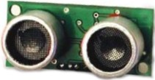
Non-contact Proximity sensors
Ultrasonic (Sonar) sensors
Ultrasonic sensor utilize the reflection of high frequency (20KHz) sound waves to detect parts or distances to the parts.
In general, ultrasonic sensors are the best choice for transparent targets. They can detect a sheet of transparent plastic film as easily as a wooden pallet.
Different Colors has no effect
The most common configurations are the same as in photoelectric sensing: through beam, retro-reflective, and diffuse versions.

Slide 41
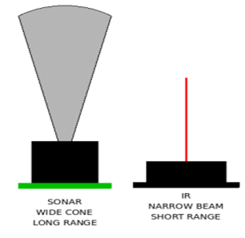
Non-contact Proximity sensors
Ultrasonic (Sonar) versus IR sensors
The primary difference is that sonar has a wide detection cone and longer range
Unlike IR sensors, sonars are slightly harder to deal with when it comes to multiple sensors.
Because of the wide cone, and how sound can reflect, they can interfere with each other quite easily.
Typically, you must allow a 50ms between each firing of a sonar sensors, to let the ping die off.
If you have multiple sensors, you can only ping one at a time, and must still obey this 50ms ring down time or have each sonar operating at a different sound frequency

